Slide 1
Records and Transparency: Good or Bad? Ben Worthy

Slide 2
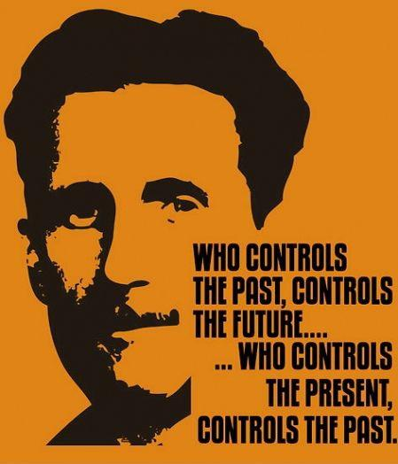
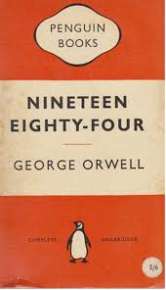

Slide 3
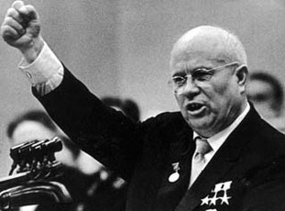
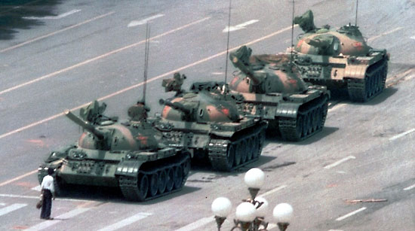

Slide 4
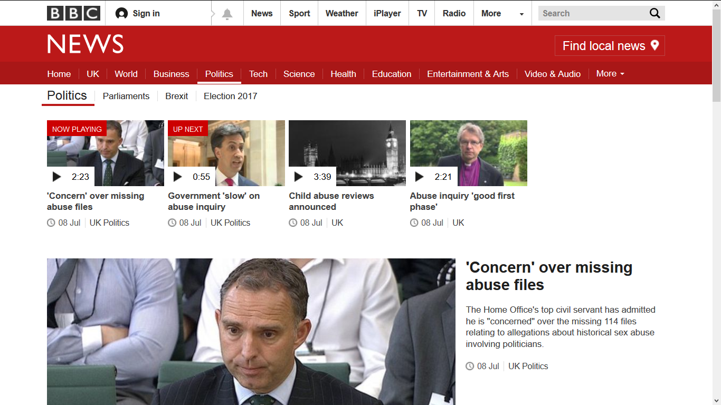

Slide 5
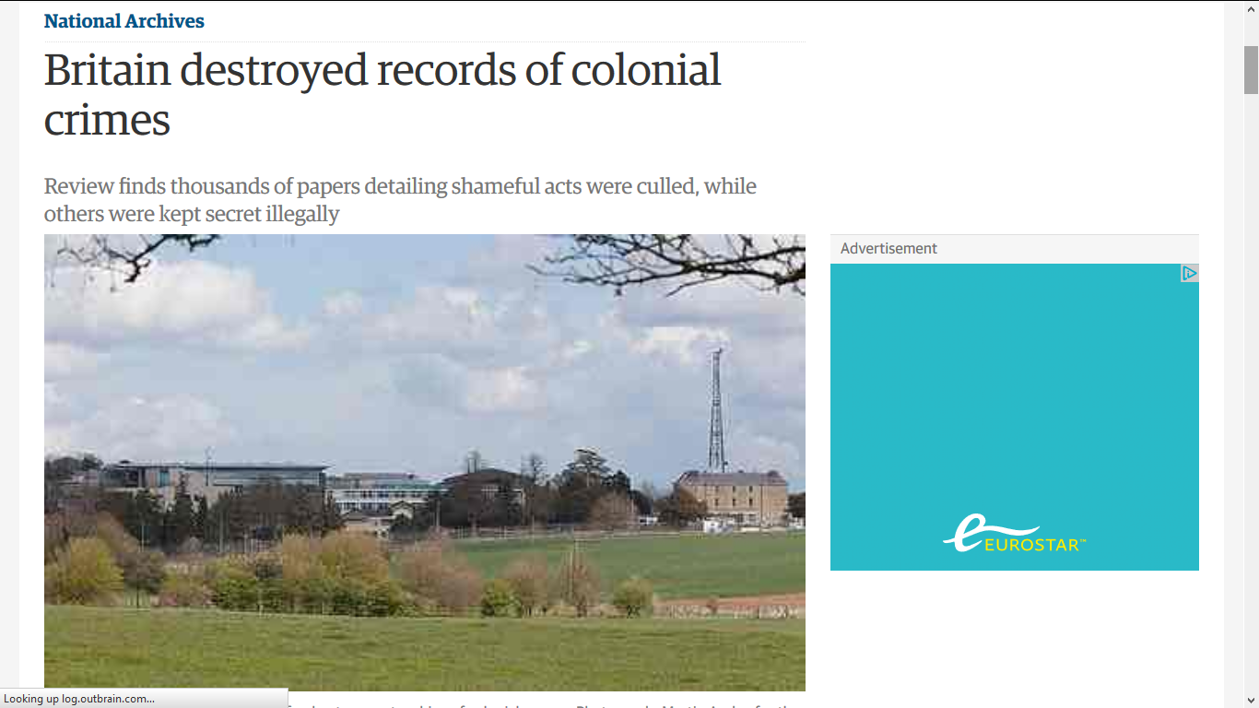

Slide 6
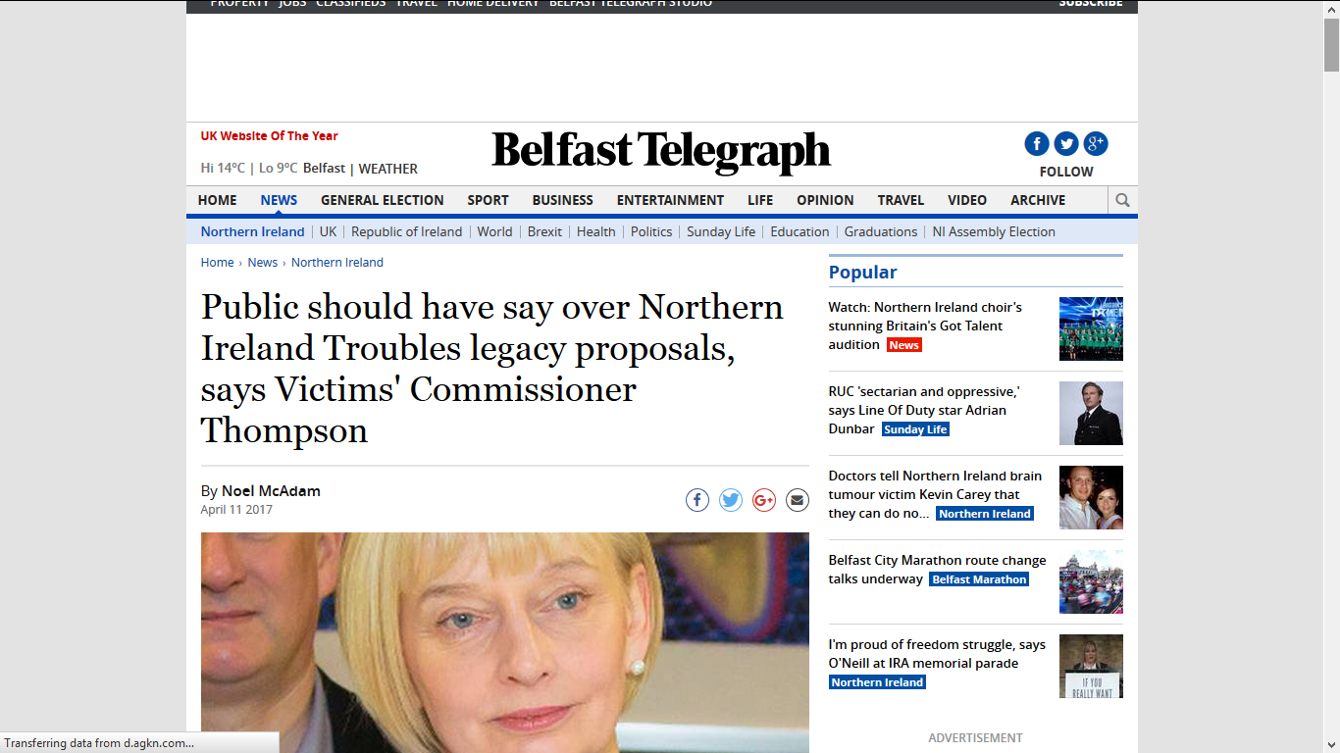

Slide 7
Freedom of information legislation is only as good as the quality of the records and other information to which it provides access. Access rights are of limited value if information cannot be found when requested or, when found, cannot be relied upon as authoritative.
(S46) Code of Practice on Records Management

Slide 9
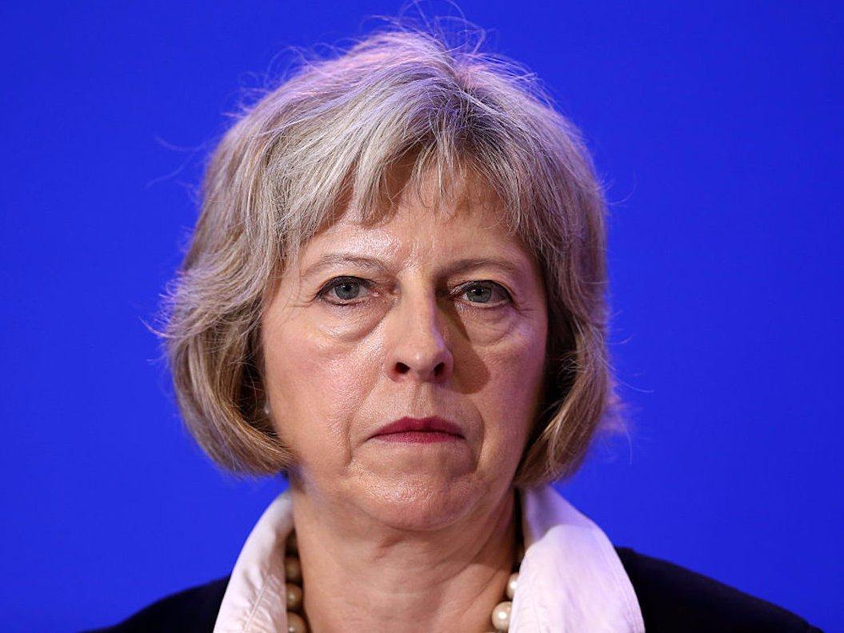
Politicians
Freedom of information (dislike)
Open Data (like)
Records management (not interested)

Slide 10
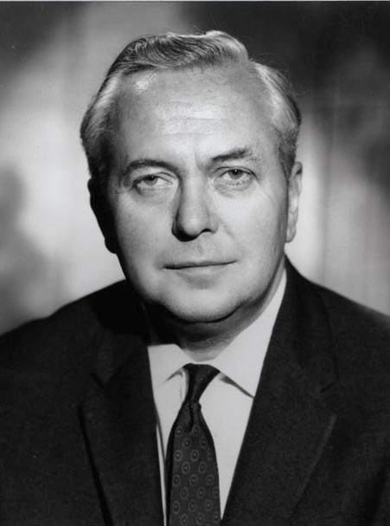
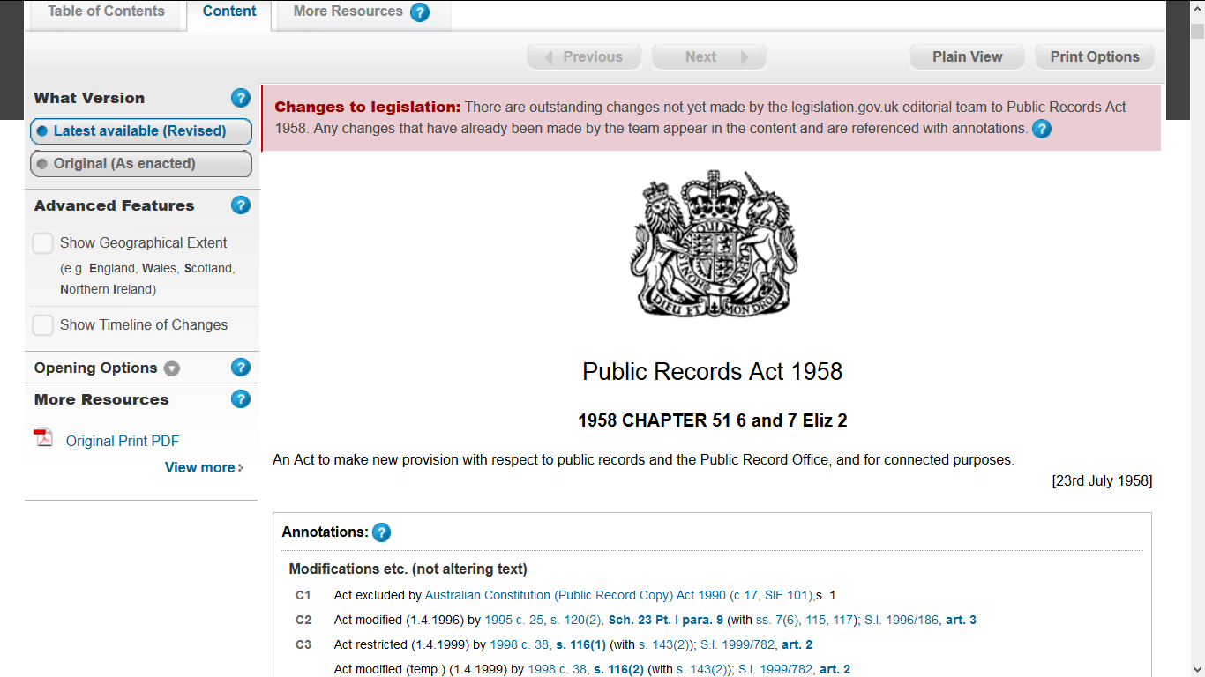

Slide 11
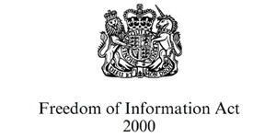

Slide 12
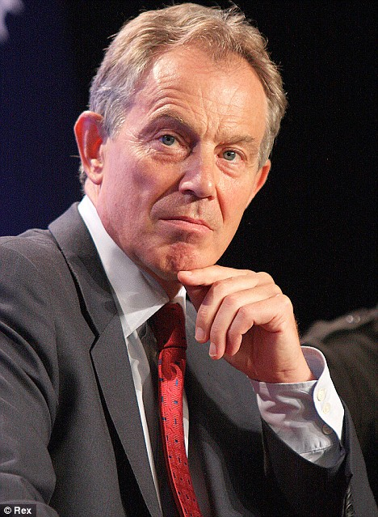
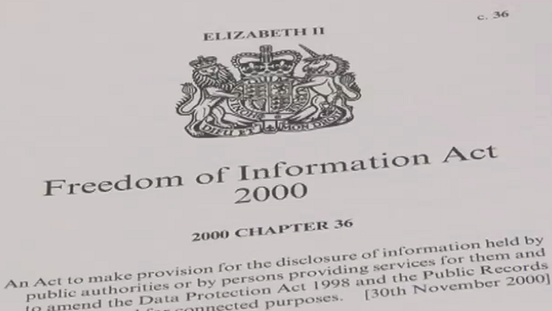
Pause 2000-2005

Slide 13
FOI in the UK 2005-2017
Around 50,000 requests
Public, media and NGOs
Local government get 80%
Popular with media
Politicians do not like-fees, veto, complaints

Slide 14
Retrospective

Slide 15
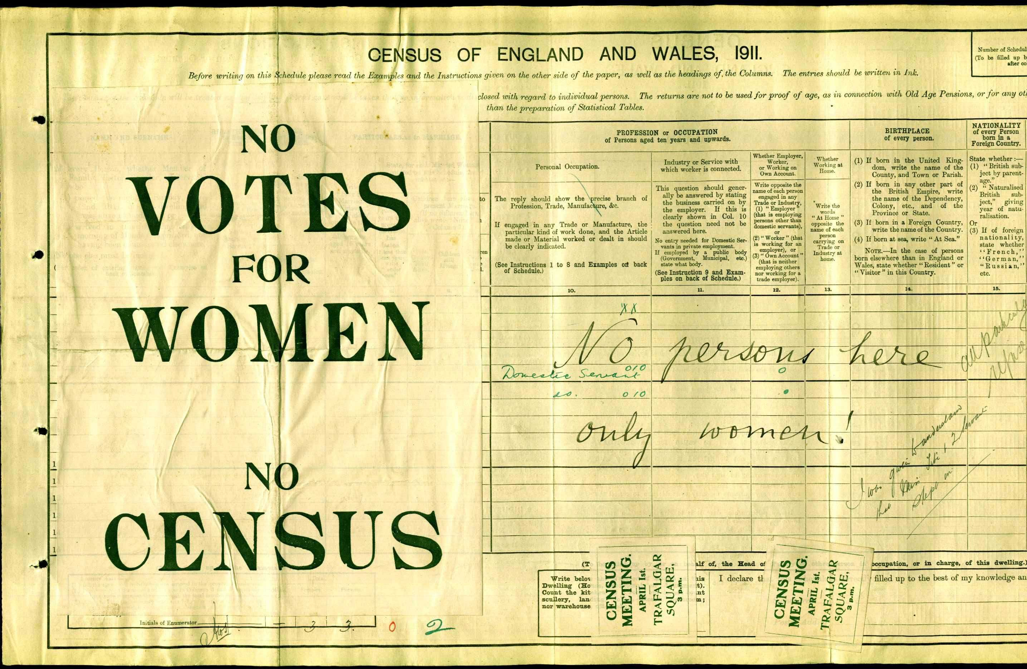

Slide 16
Chilling?
Tony Blair: ‘not practical for government … if you are trying to take a difficult decision and you’re weighing up the pros and cons, you have frank conversations … if those conversations then are put out in a published form … you are going to be very cautious.’ (Guardian 1/9/2010)
David Cameron ‘furring up the arteries of government’ (BBC 7/3/2012).
The former Cabinet Sectary Gus O’Donnell claims it has ‘hamstrung’ government: two hypothetical and one based on the coalition negotiations (Justice Committee 2012).

Slide 17
Is There a Chilling Effect?
Is it happening?
Anecdote abounds but hard evidence is minimal
Few examples where trouble
Fear of not having a record?

Slide 18
Is There a Chilling Effect?
Is it FOI?
Use of electronic communications?
New ways of making decisions?
Fear of leaks?
Was everything ever written down?

Slide 19
Is There a Chilling Effect?
The Justice Committee (2012d, 32) ‘was not able to conclude, with any certainty that a chilling effect has resulted from the FOI Act’. In central government there was concern, with isolated instances but no general trend (Hazell et al. 2010; Waller et al. 2009).
At local government level similarly there appear to be a few exceptional cases but no systematic effect (Worthy 2013; Shepherd et al. 2011).
In both Scotland and England there was some concern at informal recording but also some evidence of a positive professionalising effect on records (Taylor and Burt 2010; Richter and Wilson 2013).

Slide 20
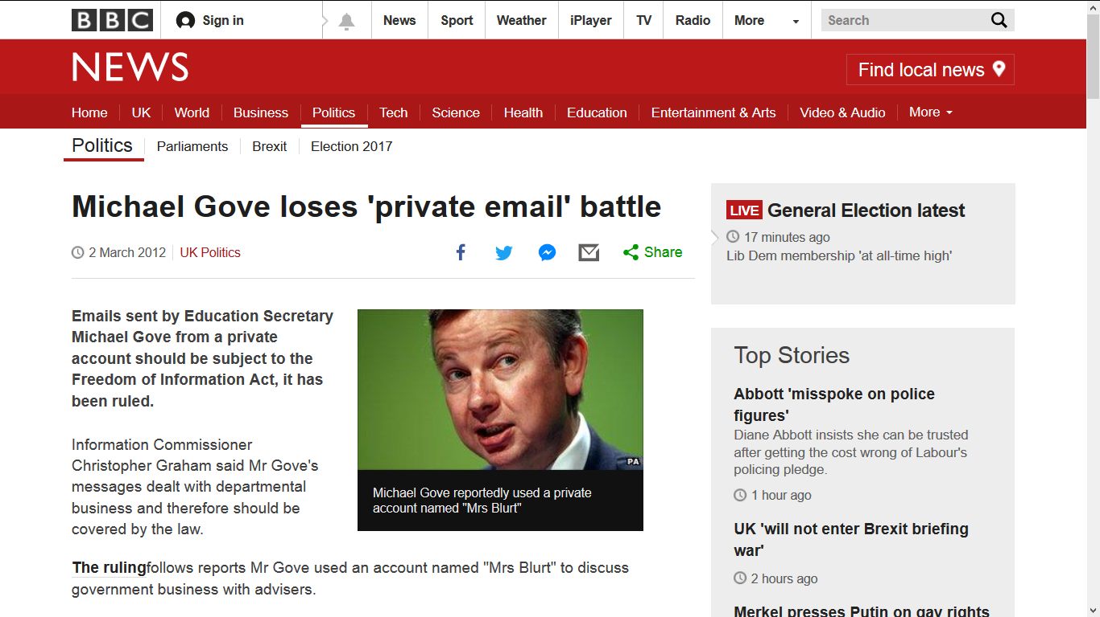

Slide 21
Is there a ‘discipline effect’? (Shepherd et al 2009)
Improve records?
Use to organise and create a policy?
Improve professionalism and standards

Slide 22
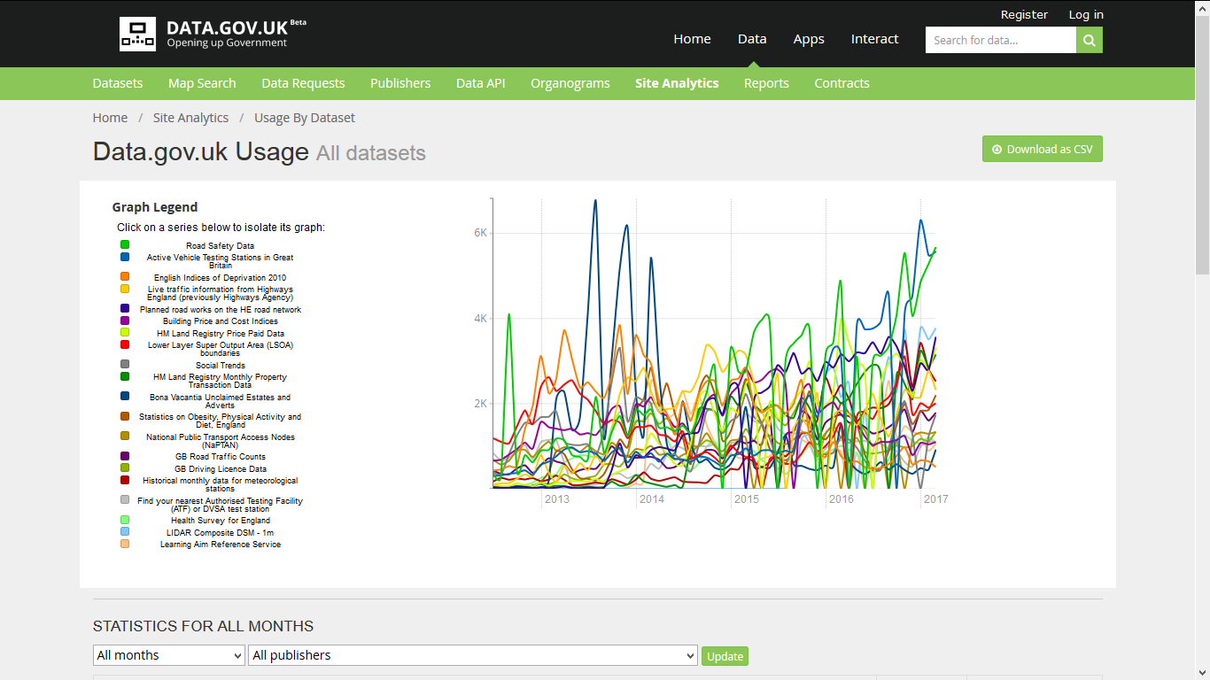

Slide 23
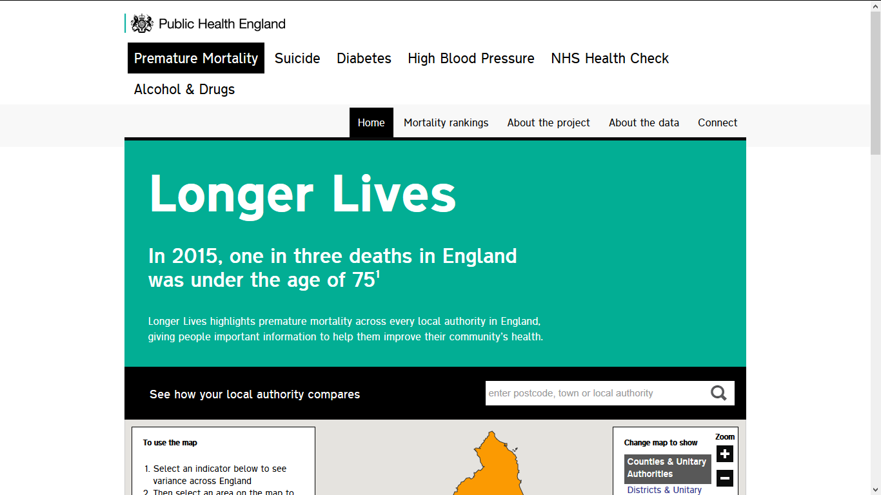

Slide 25
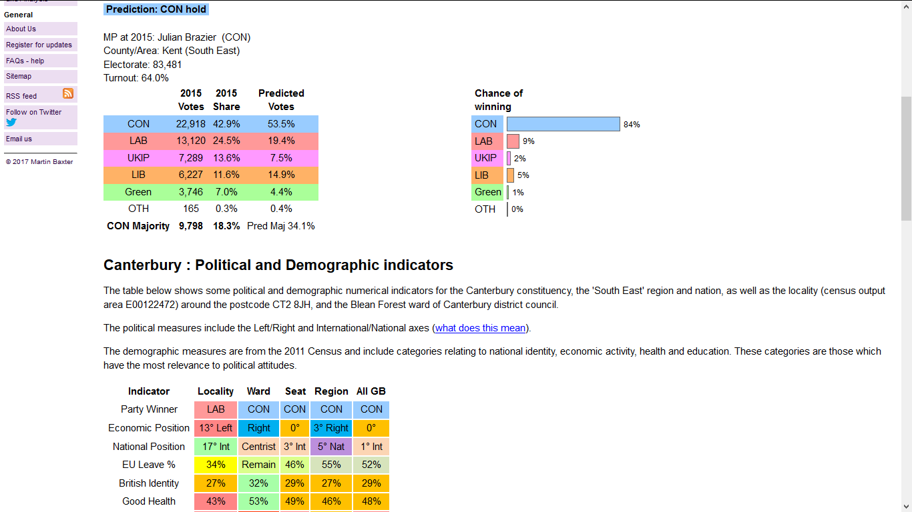

Slide 27
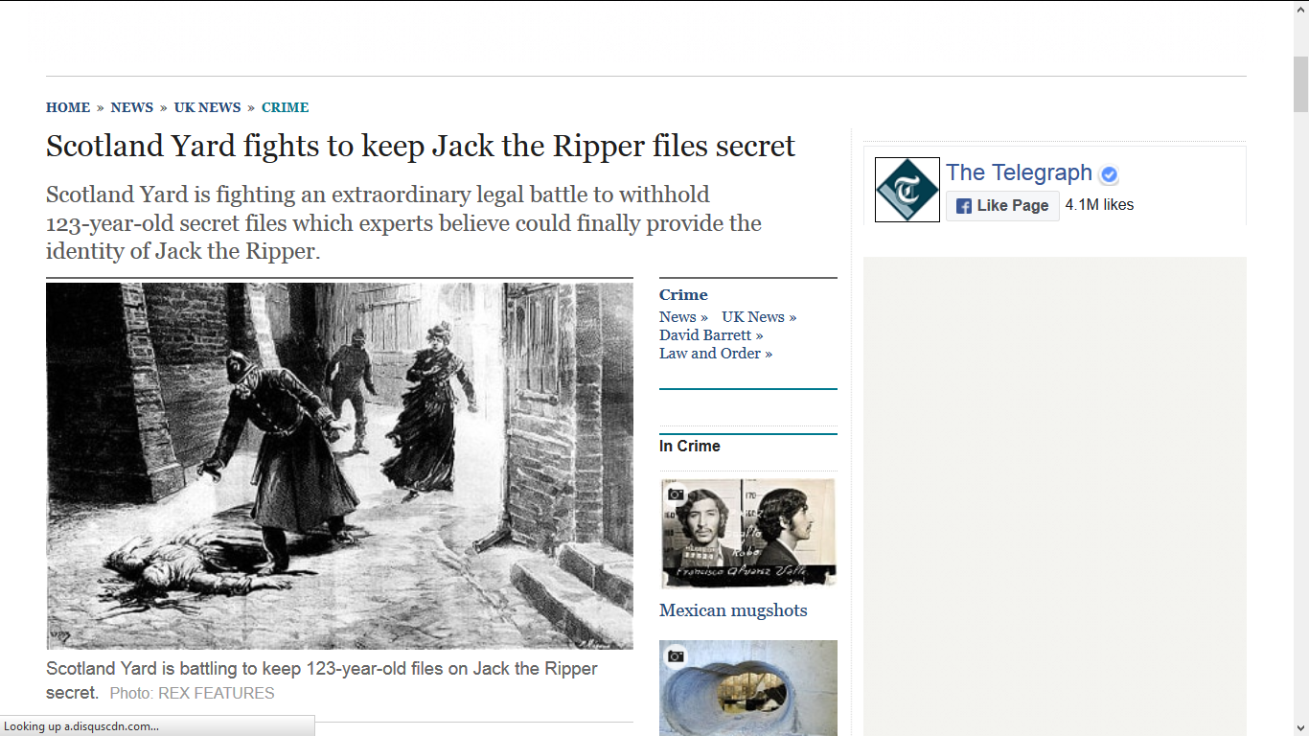

Slide 28
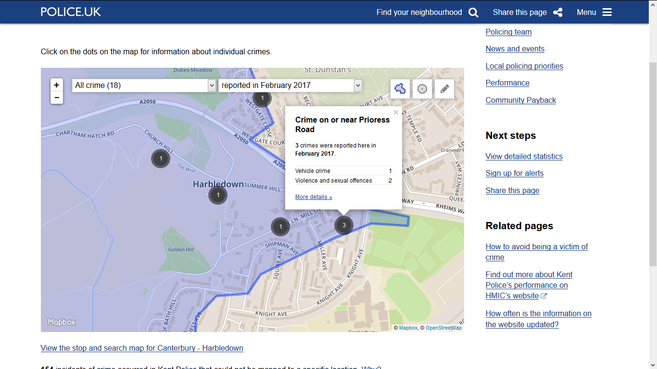

Slide 29
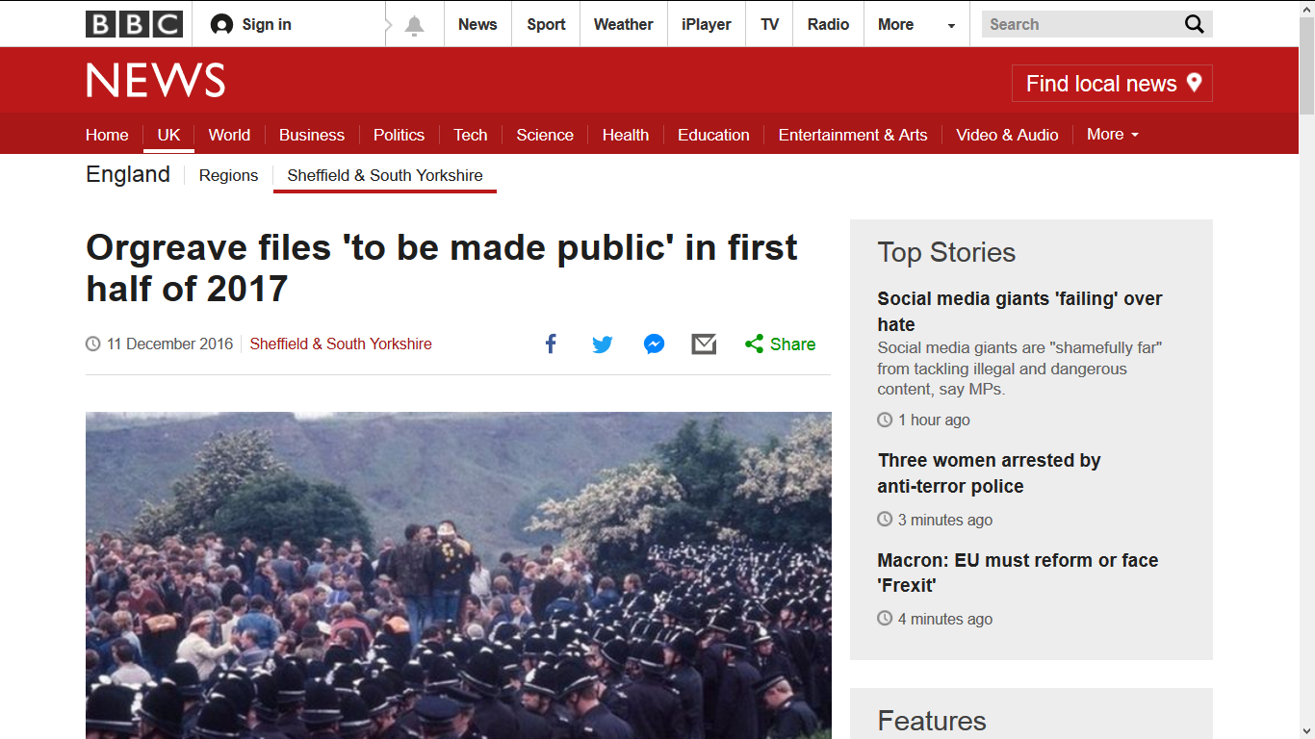

Slide 31
Brexit and Openness in the UK

Slide 32
Lessons?
Need to get support and interest
Work close together
Same problem-same solution?

Slide 33
Gràcies-Thank You
Email: b.worthy@bbk.ac.uk
View my research blog here
Ben Worthy (2017) The Politics of Freedom of Information: How and why governments pass laws that threaten their power (Manchester University Press).

